Slide 1
The Yeast ORFan/GUF Gene Project: Discovery of yeast gene function in undergraduate courses www.yeastorphanproject.com
Jill Keeney (Juniata College, PA)
tammy tobin (Susquehanna university, PA)

Slide 2
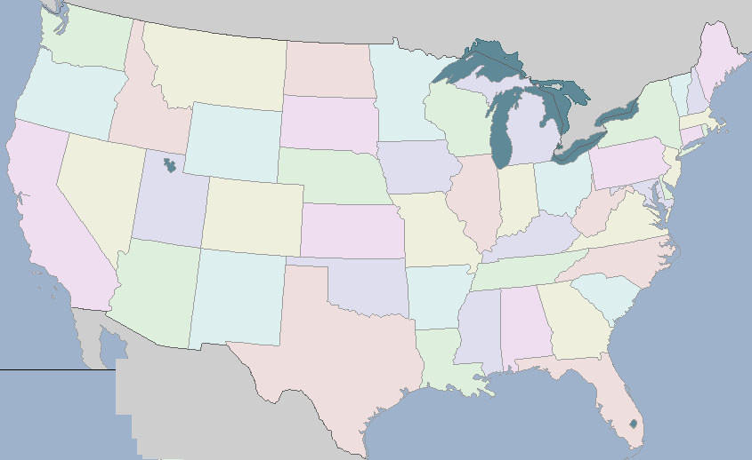
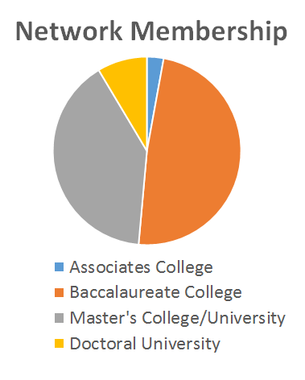
Who We Are…
Univ. Minn. Duluth
Crown College
Lawrence University
Gustavus Adolphus
College
Susquehanna University
Dominican Coll.
Juniata College
NYIT
North Central College
Mount Aloysius College
Dickinson College
Univ. of Pittsburgh
Swarthmore College
Ohio Wesleyan University
MacDaniel College
Morgan State University
Goucher College
Ohlone College
Truman State University
Northern Kentucky Univ.
James Madison Univ.
Salisbury University
Univ. of Mary Washington
Webster University
Longwood Univ
Hampden-Sydney College
Kentucky Wesleyan
Univ
High Point University
Western Carolina University
CSU San Marcos
Furman University
Rhodes College
USC Aiken
Arizona State University
Georgia College
Austin College
Columbus State University
Houston Baptist University
Xavier University
Humacao Community College
Inter-American University of PR
Steering Committee Member
Member Institution

Slide 3
Project Goals
Increase use of course-based undergraduate research experiences at participating institutions
CUREs have been shown to:
Increase student knowledge and independence
Elevate confidence and sense of accomplishment
Increase interest in relevant subject matter & research outside of coursework
Increase inter-institutional undergraduate research collaborations
Assign functions to unknown yeast genes (GUFs)

Slide 4
ORFan vs. GUFs
ORFan Genes
Unknown functions
Taxonomically isolated (no homologs in other lineages)
Poorly studied
Often too high risk for grad students and post-docs
GUFs (Genes of Unknown Function)
Have at least one unknown gene ontology (GO) term in SGD (Saccharomyces genome database-www.yeastgenome.org)
Cellular component
Molecular function
Biological process

Slide 5
SGD gene status July 2019
6604 ORFs
78% verified-experimental evidence exists that a gene product is produced in S. cerevisiae
11% uncharacterized-existence of orthologs in one or more other species, but for which there are no specific experimental data demonstrating that a gene product is produced in S. cerevisiae
10% dubious-ORF is unlikely to encode an expressed protein
Annotated to unknown (could be in any of the above 3 catagories)
Biological Process 1,787
Cellular Component 1,307
Molecular Function 2,557

Slide 6
Bioinformatics Modules Overview
Module 1-Introduction
Module 2-Structure Based Evidence-part 1
Module 3-Structure Based Evidence-part 2
Module 4-Multiple sequence alignment
Module 5-Cellular Localization Data-part 1
Module 6- Cellular Localization Data-part 2
Module 7-Gene Deletion Phenotypes
Module 8-Genetic/Physical Interactors & Expression Data
Modules can be downloaded at http://www.yeastorfanproject.com/lab-modules/

Slide 7
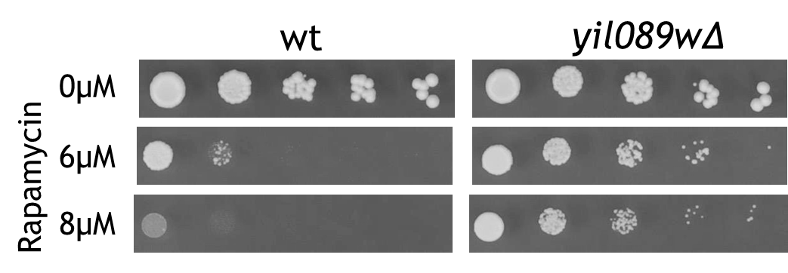
Wet Labs
Gene deletion construction (homologous recombination and selection of PCR-generated deletion cassette.
Phenotype screening
GFP tag localization

Slide 8
Student Learning Outcomes (assessment tools included in network)
Vision and Change Alignment
Project-Specific Student Learning Outcomes
Define terms relevant to the project
Select appropriate bioinformatics databases to answer specific questions
Appropriately interpret and analyze results from bioinformatics tools
Discuss the evolutionary relationship of genes
V&C Core Competency | ORFan Project Activity
Use modeling and simulation | Students use web-based algorithms to predict protein structure and localization.
Apply the process of science | Students use bioinformatics findings to craft and test hypotheses.
Communicate and collaborate | Lab reports, posters, or presentations; Virtual lab meetings with other member institution(s).

Slide 9
Interactive group work
Choose one of the ORFan/GUFs on the handout [YLR064W or YHR033W]
Work through the tools on the back
Hypothesize a function
Design an experiment
Discussion:
1. what courses do you teach?
2. Do you include a CURE component in any of your classes?
3. How could the yeast ORFan/GUF project and resources be used at your home institution?

Slide 10
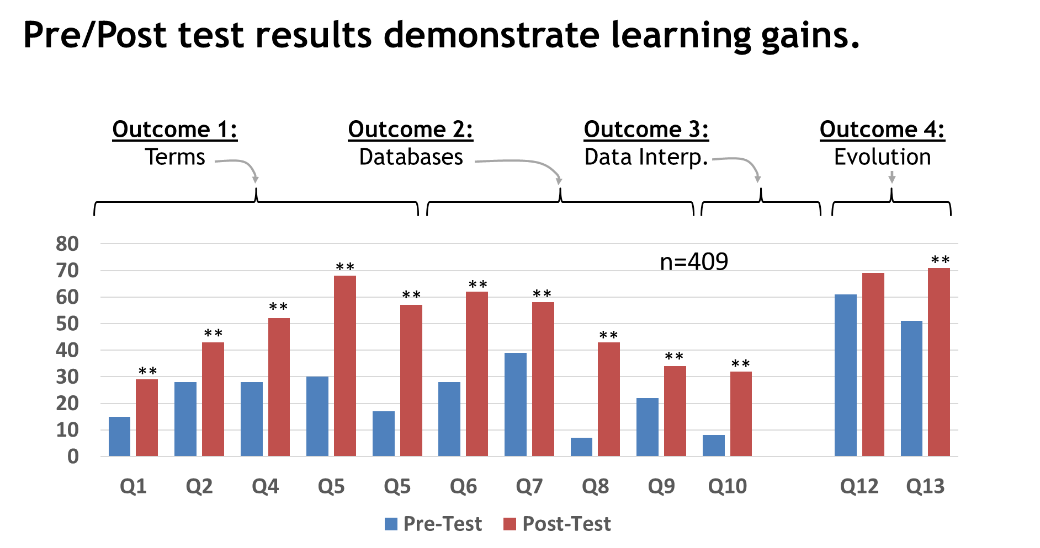
Assessment-concepts

Slide 11
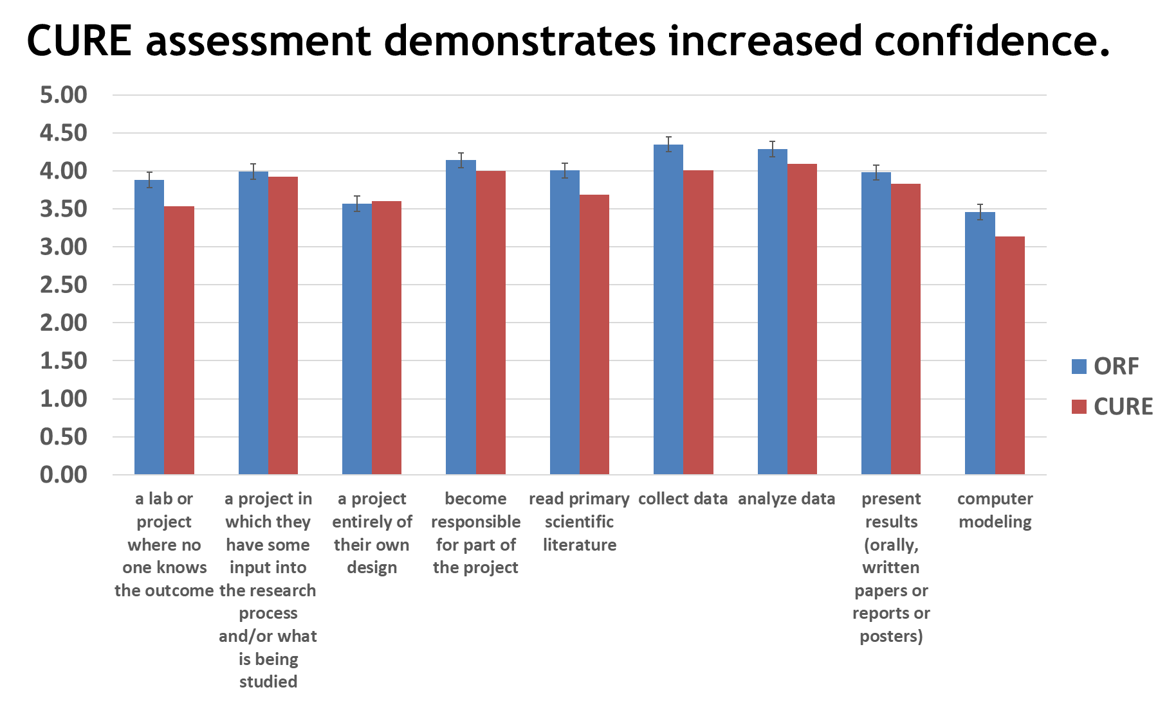
Assessment-scientific process

Slide 12
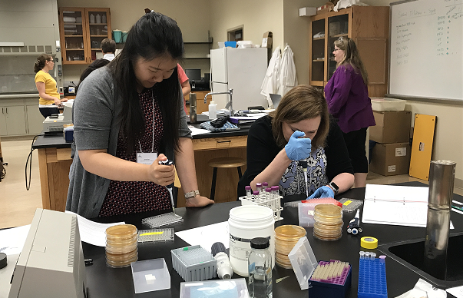
Research Coordination Network – Undergraduate Biology Education
Benefits of Membership
Access to resources (strains, primers, plasmids, etc.)
New opportunities for collaboration
Course revitalization
Faculty development
Upcoming Summer Workshop
June 2020 (adjacent to ASM)
North Central College, Chicago, IL

Slide 13
Acknowledgments
Jill Keeney – Principal Investigator (Juniata College)
Steering Committee
David Aiello (Austin College)
Pamela Hanson (Furman University)
Laurie Issel-Tarver (Ohlone College)
Steve Johnston (North Central College)
David Kushner (Dickinson College)
Mary Miller (Rhodes)
Erin Strome (Northern Kentucky University)
Tammy Tobin (Susquehanna University)
Workshop Participants
National Science Foundation

